Slide 1
Facebook Marketplace Data Analysis
Assignment Summary & Insights

Slide 2
Dataset Overview
Facebook Live Sellers data from Thailand
Data includes reactions, comments, shares, types of posts, etc.

Slide 3
Concept of correlation and steps to find correlation matrices
First, I converted the 'Status Published' column from text format to datetime format and created separate columns for date, hour, and year using methods from the datetime library
Next, I removed all unnecessary and null columns to make the dataset more concise and suitable for modeling and analysis. I then checked whether any null values were still present in the remaining columns.Then correlation matrix between different columns is shown in the following slides.
Following this, a correlation matrix between different columns is presented in the subsequent slides. The concept behind the correlation values is as follows: a correlation value between 0 and 1 indicates a positive correlation, a value between -1 and 0 indicates a negative correlation, and a value of 0 indicates no correlation.

Slide 4
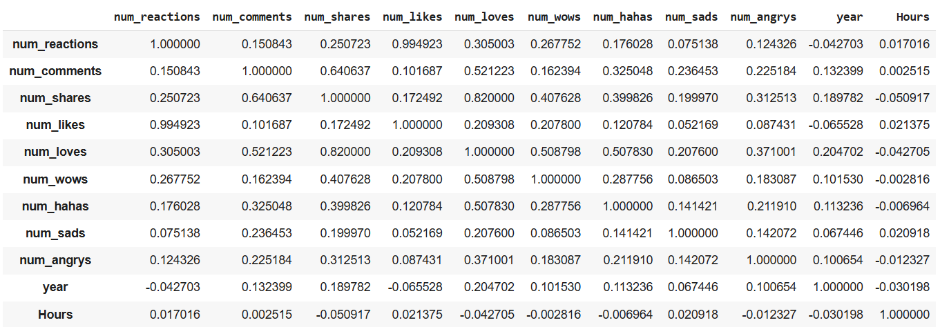
The correlation between time of upload (status_published) and the num_reaction : 0.017016 (It reprents small positive correlation).
Hours num_reactions
Hours 1.000000 0.017016
num_reactions 0.017016 1.000000
correlation between the number of reactions (num_reactions) and other engagement metrics such as comments (num_comments) and shares (num_shares) are:

Slide 5
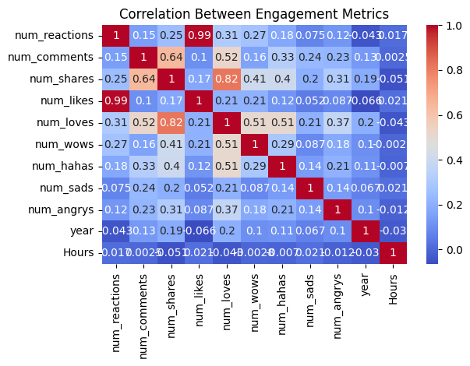
Heatmap of Correlation matrices
Correlation value close to 1 represents higher positive correlation. The diagonal value of the matrix always 1 because of same column in x and y axis.
And the colour bar represents the weightage of the correlation in the heatmap representation.

Slide 6
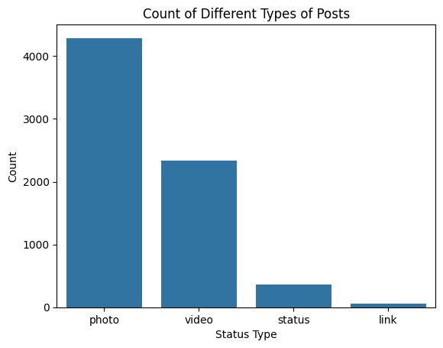
Count of different types of post and average of the required columns
The count of different types of posts in the dataset are:
count
status_type
photo 4288
video 2334
status 365
The average value of num_reaction, num_comments, num_shares for each post type are 230.11716312056737, 224.3560283687943 and 40.022553191489365 respectively.

Slide 7
Data preprocessing for the k means clustering model
Since categorical values cannot be directly used in machine learning models, all categorical columns must be converted into numerical representations that the models can interpret. To achieve this, I used the OneHotEncoder from the sklearn library to transfer the status type categorical variable to numerical variable..
Next, I applied feature scaling using the MinMaxScaler class, which normalizes the feature values to a common scale. This step is crucial to eliminate bias caused by features with larger ranges dominating the learning process.
Important: Do not include the columns generated by OneHotEncoder in the feature scaling process."

Slide 8
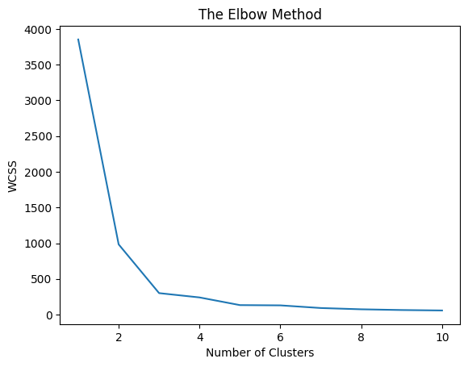
Steps to find elbow curve
The Elbow Method is used to determine the optimal number of clusters (K) for clustering analysis. It relies on the Within-Cluster Sum of Squares (WCSS), which measures the compactness of the clusters. A lower WCSS value indicates more accurate and well-defined clustering. Choosing the right value of K is important
If K is too small, distinct clusters may be grouped together, leading to poor classification.
If K is too large, it may overfit the data by assigning each point to its own cluster, increasing computational cost unnecessarily. To identify the optimal K, I ran a loop for K ranging from 1 to 10. Based on the WCSS vs. number of clusters graph, the 'elbow point' suggests that K = 5 is the most suitable number of clusters for this dataset

Slide 9
Results of clustering and graphical representation
After selecting K = 5, the dataset was successfully classified into five distinct clusters based on the selected features.
I used random_state = 42 to ensure that the clustering process produces consistent results each time it is run, while still introducing randomization to avoid any bias. The cluster labels were stored in a new column named y_means.
To visualize the clustering results, I plotted three different curves using selected feature columns. These visualizations are shown in the following slide.

Slide 10
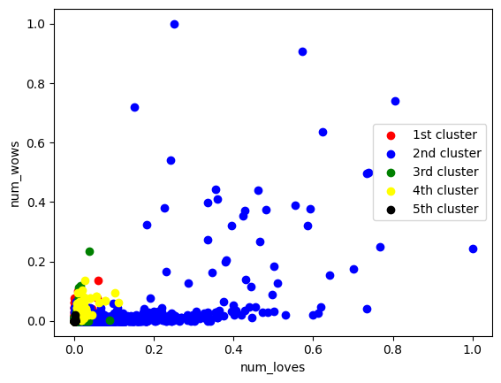
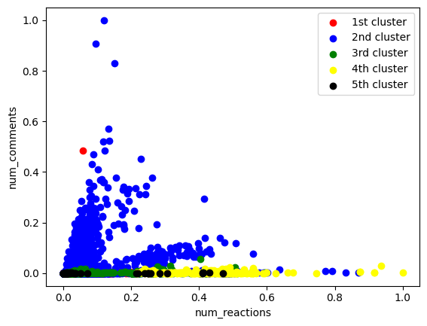
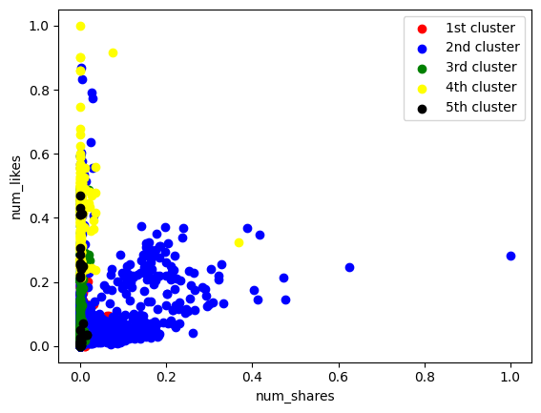
Fig.1)num_loves vs num_wows
Fig. 2)num_reactions vs num_comments
Fig .3) num shares vs num_likes
Fig.1
Fig.2
Fig.3

